Slide 1
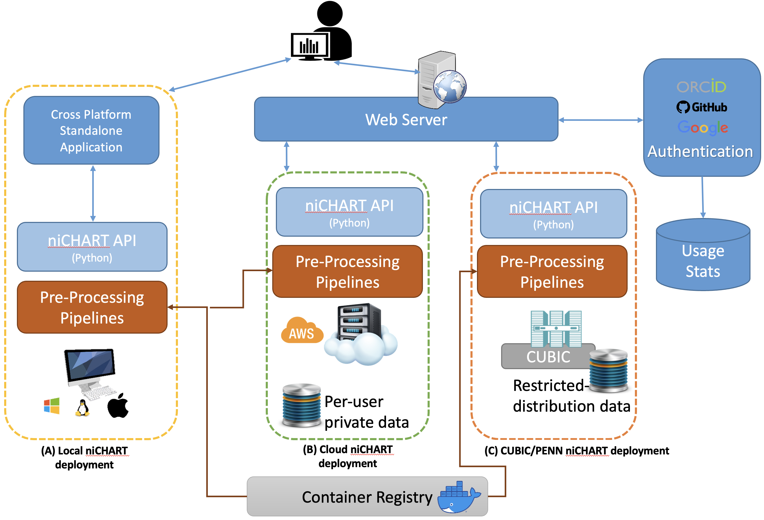
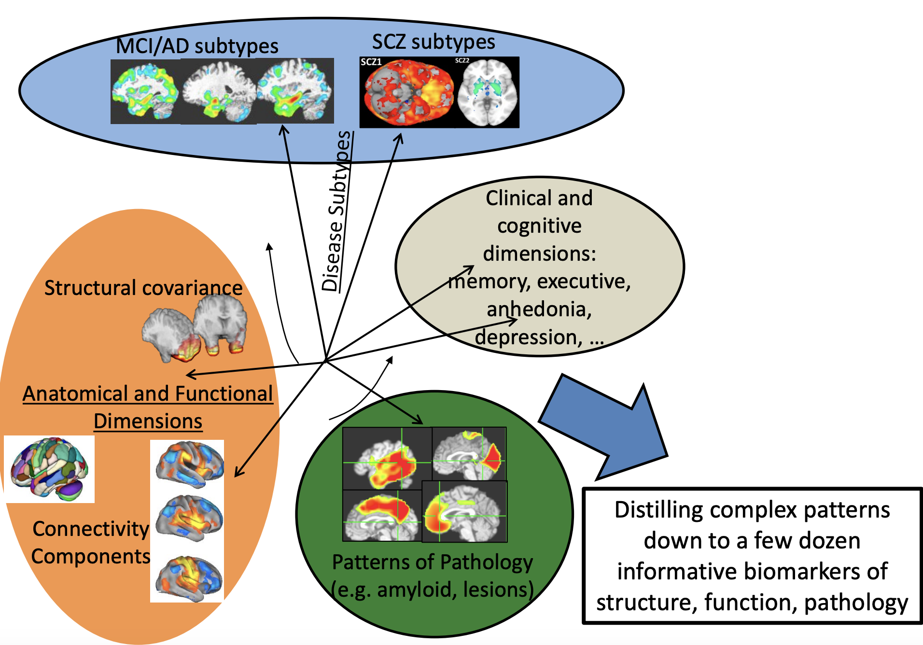
NiCHART: From Neuroimaging Big Data to Individualized Imaging Signatures of Disease and Aging
A framework to:
process multi-modal MRI
extract rich and accurate imaging descriptors,
harmonize to a large reference set
apply machine learning models trained on reference set
derive individualized “NeuroImaging Chart” values

Slide 2
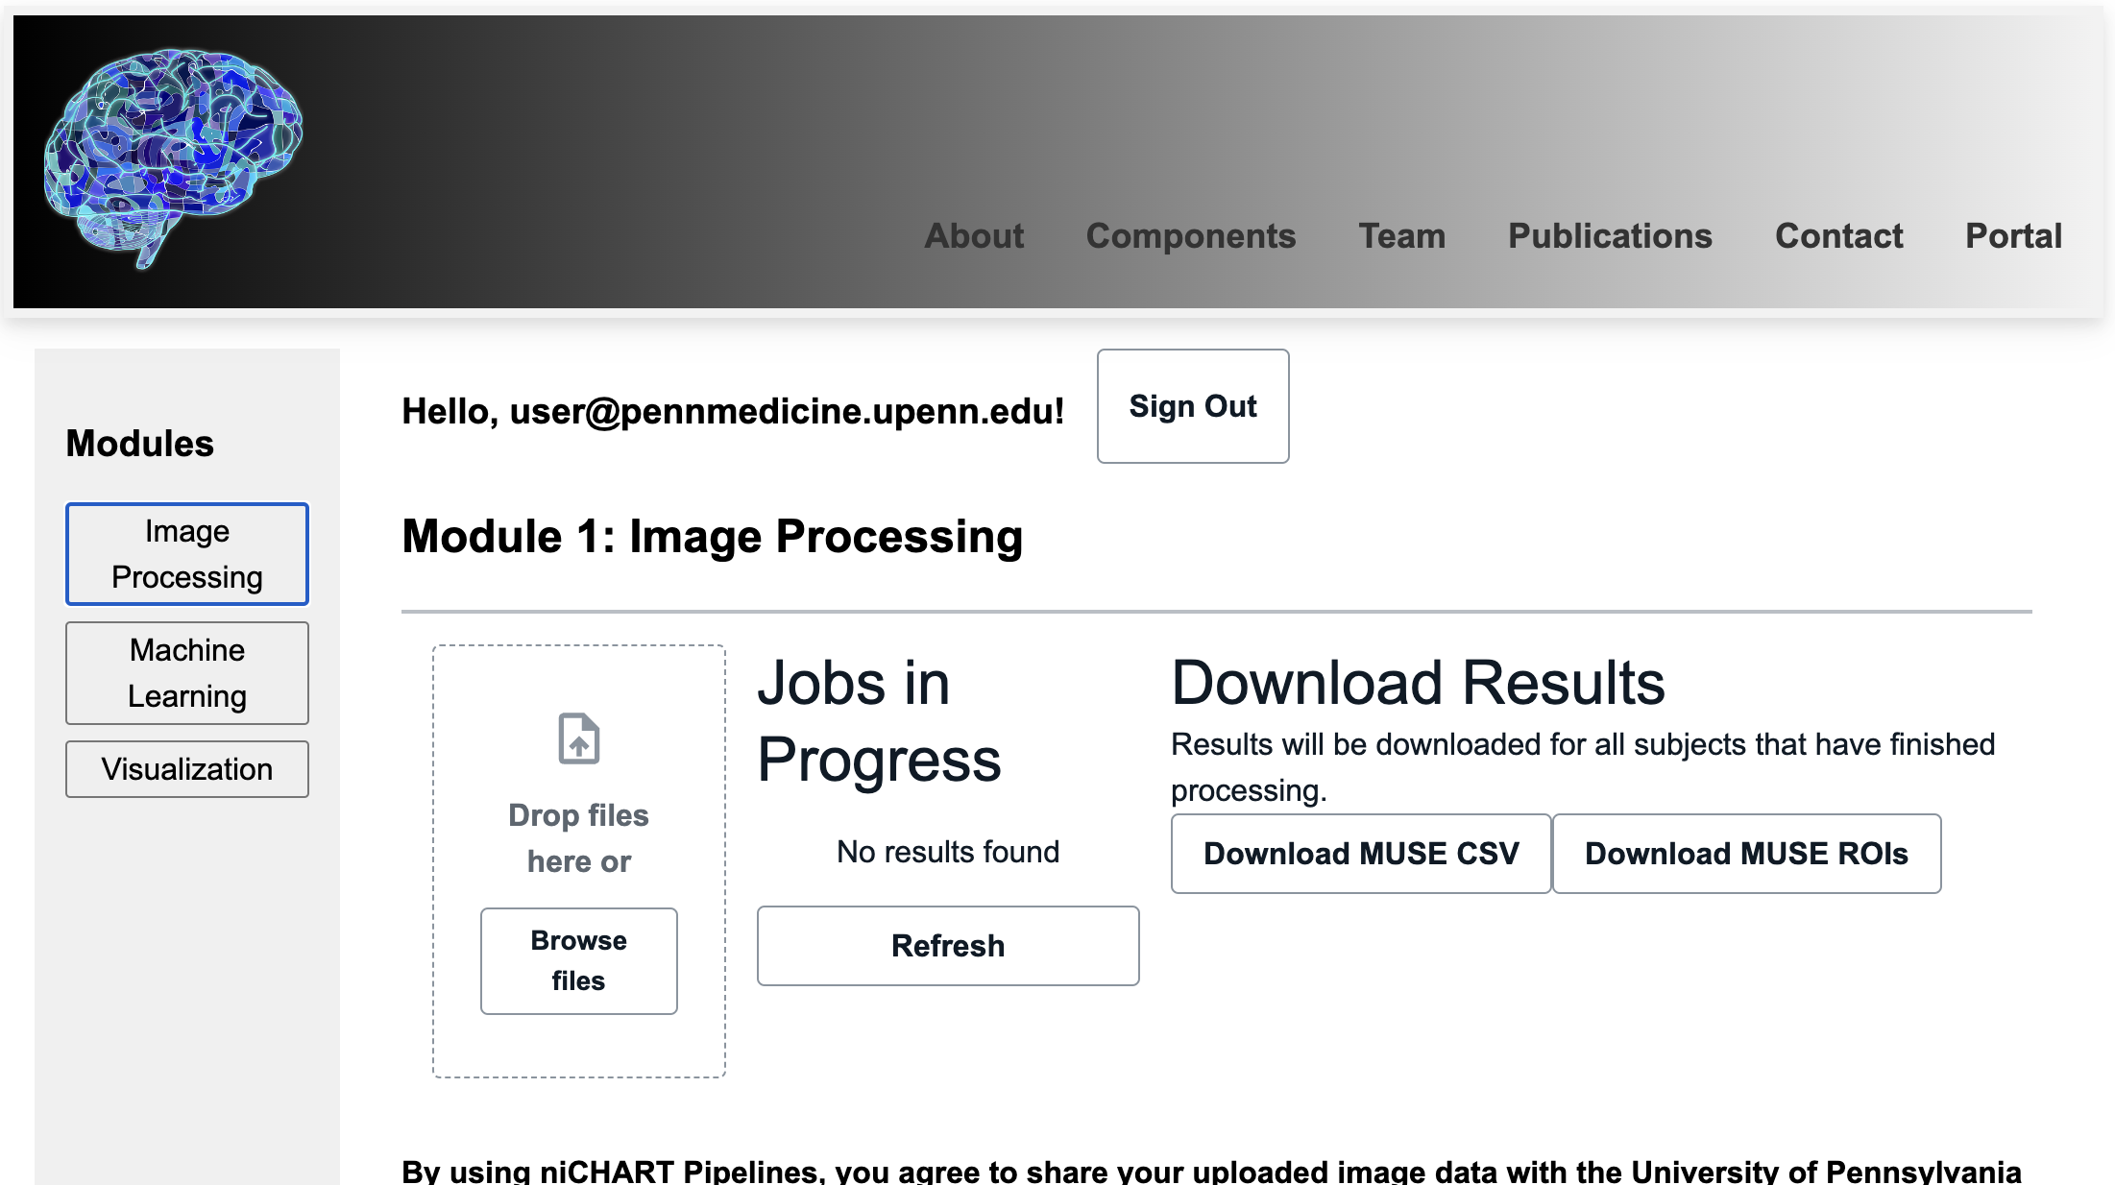
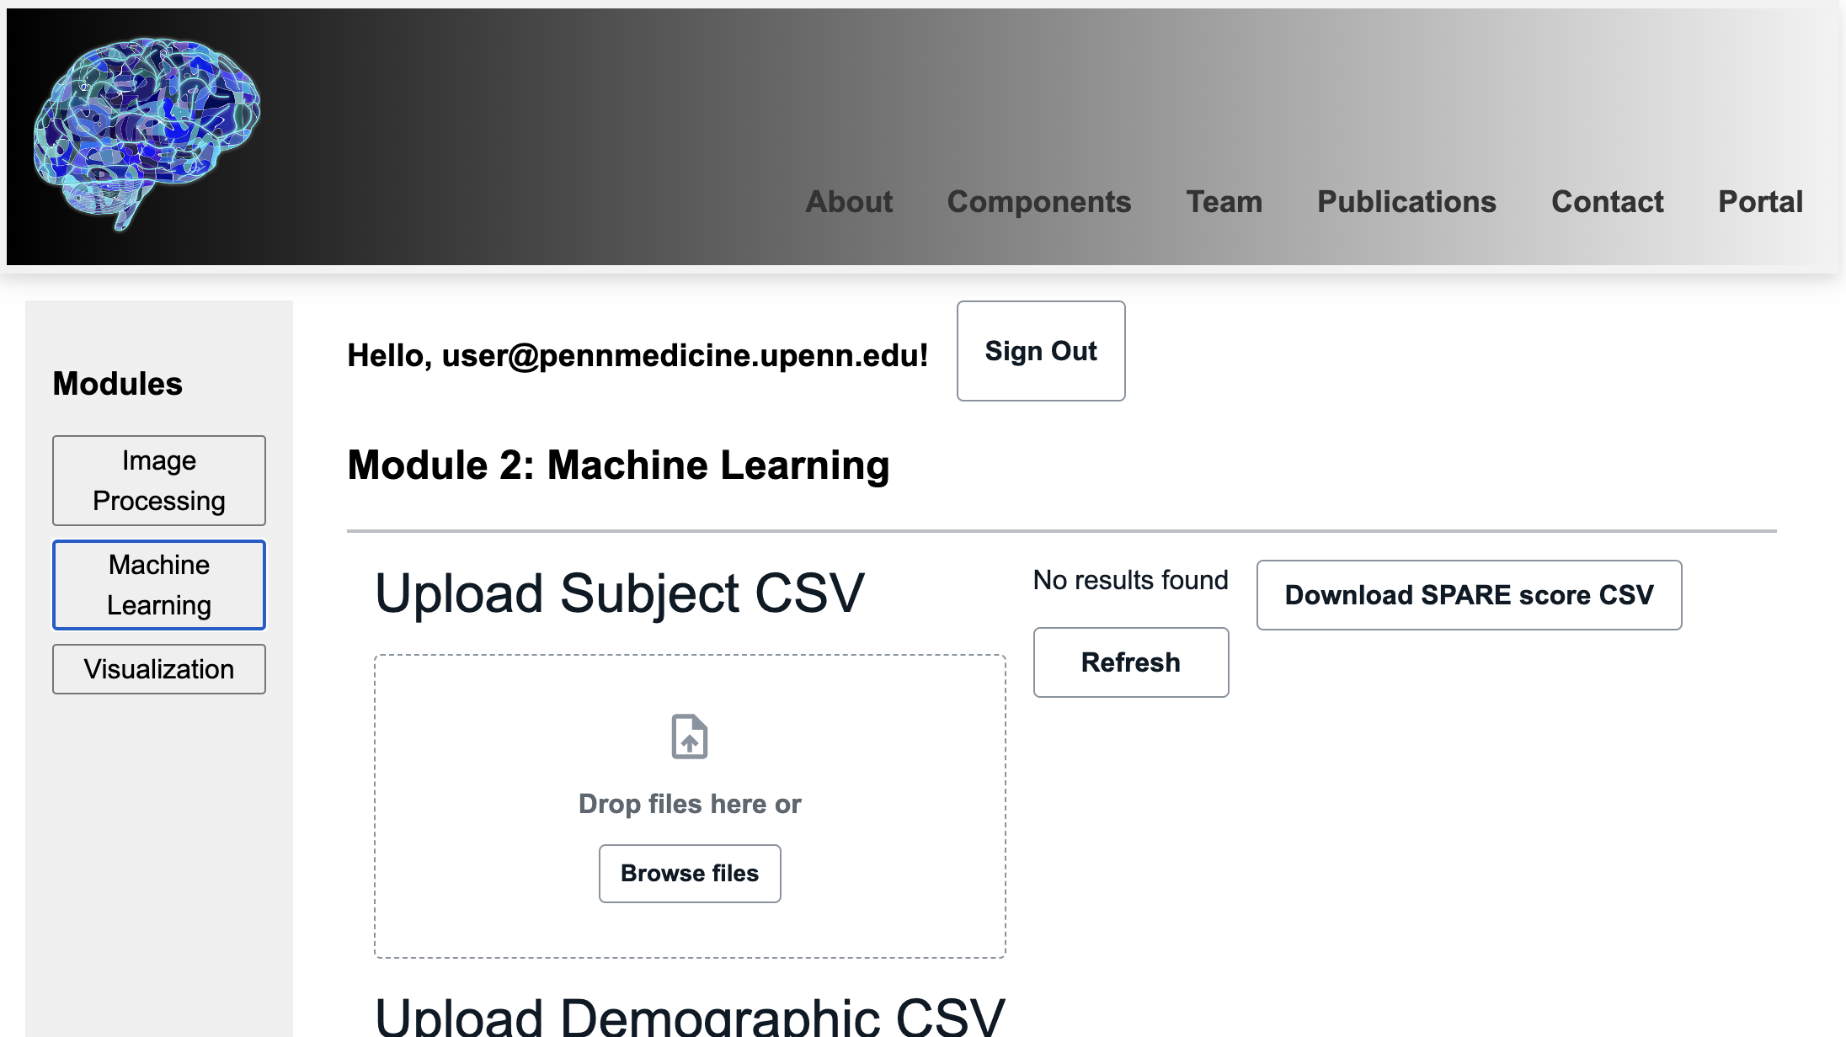
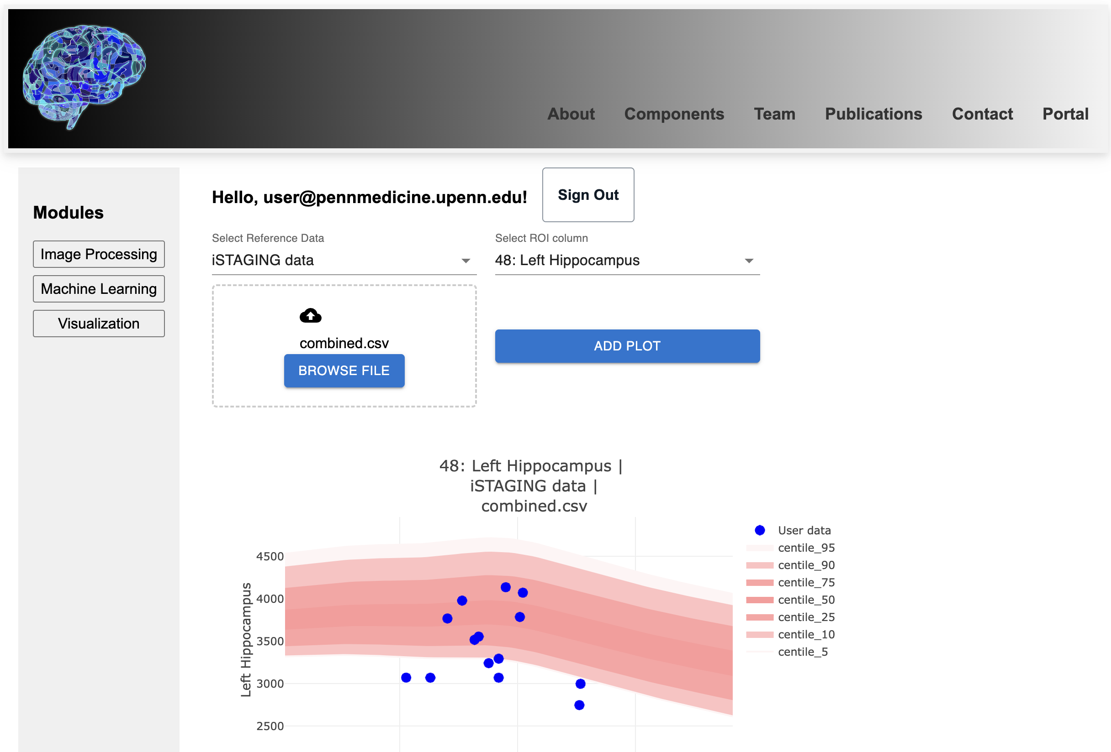
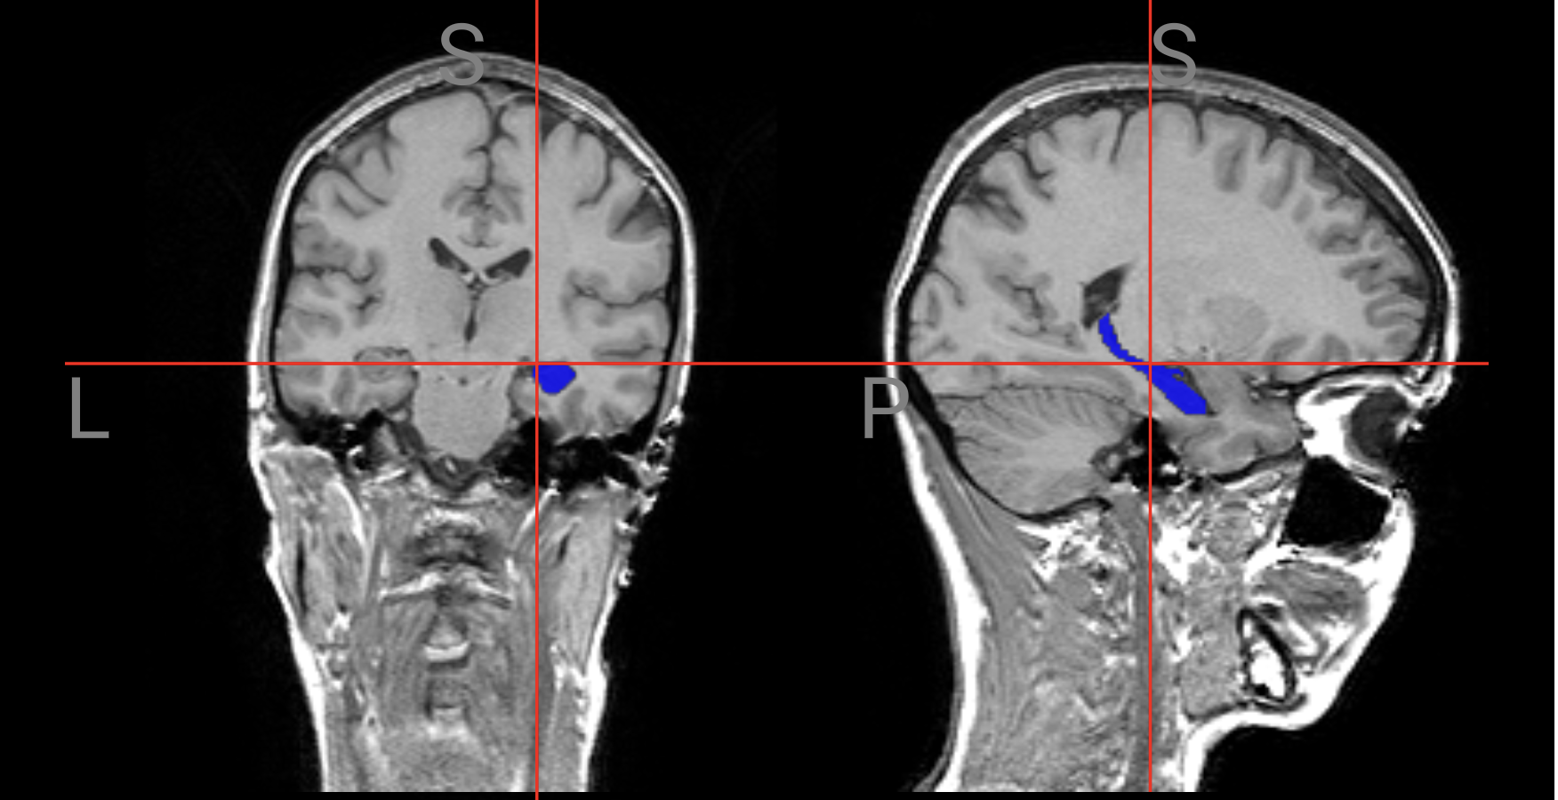

Slide 3
AWS / DLMUSE portal
3D CNN model trained on large and diverse dataset
Anatomical segmentation of Regions Of Interest n=145 in ~3.5”/scan
AWS parallelization of 64 GPU jobs per batch
Docker / Singularity container for reproducible results

